Slide 1
Mobile App Development: Types, Frameworks, Architecture and Cost Estimation
A Comprehensive Overview
Presented by GROUP12
April, 2025

Slide 2
Agenda
01
02
03
04
05
Types of Mobile Applications
Mobile App Development Frameworks
Architectural Patterns & Design Principles
Gathering App Requirements
Cost Estimation Strategies

Slide 3
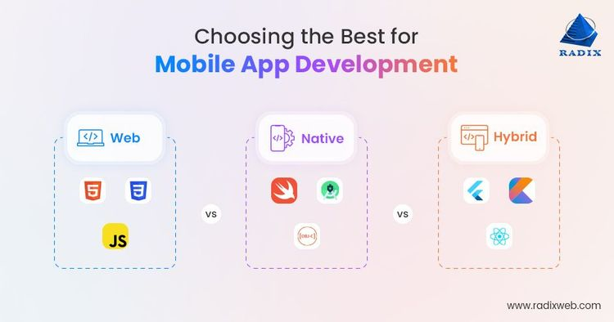
Types of Mobile Apps
Web Apps
Browser-based (HTML5, CSS, JS).
Pros: Cross-platform, low cost.
Cons: Limited offline access, slower performance.
Examples: Amazon, Netflix.
Native Apps
Platform-specific (iOS, Android, Windows).
Pros: High performance, offline access.
Cons: Multiple codebases, higher cost.
Examples: WhatsApp, Spotify.
Hybrid Apps
Blend of native and web (e.g., Ionic, Cordova).
Pros: Single codebase, native-like UI.
Cons: WebView limitations.
Examples: Instagram, Gmail.

Slide 4
Framework Comparison Overview
Key Framework
React Native (JavaScript/TS)
Flutter (Dart)
Xamarin (C#)
Ionic (HTML/CSS/JS)
Comparison Metrics
Performance, Cost, Time-to-Market, Community.

Slide 5
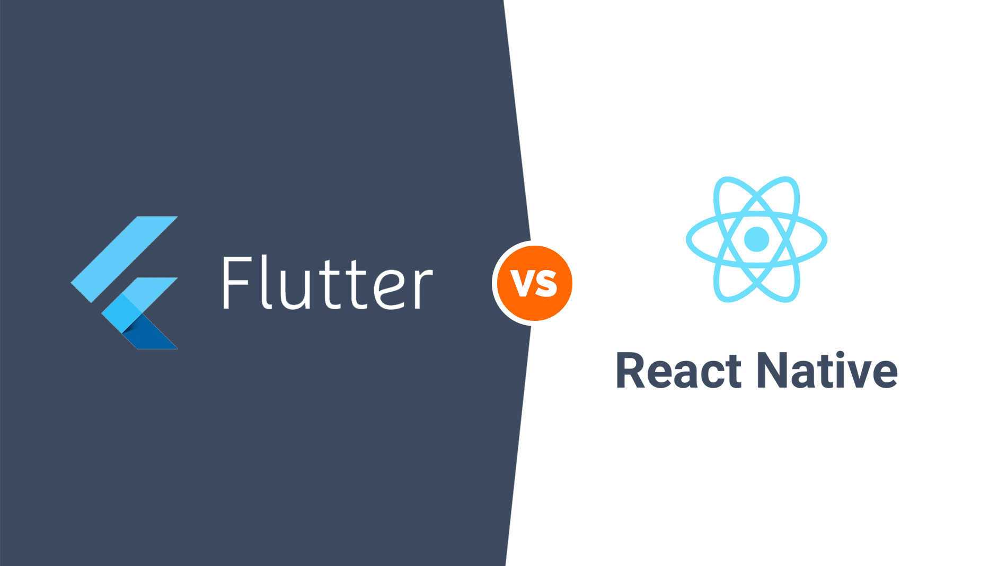
React Native
Language: JavaScript/TypeScript
Performance: ⭐⭐⭐⭐ (Bridge-dependent)
Best For: Startups, MVPs.
Pros: Reusable code, strong community.
Cons: Requires native modules for advanced features.
Diagram Placeholder: React Native Workflow.
Flutter
Language: Dart
Performance: ⭐⭐⭐⭐⭐ (No bridge, 60fps).
Best For: Gaming/media apps.
Pros: Custom widgets, fast prototyping.
Cons: Steeper learning curve.
Diagram Placeholder: Flutter Architecture.

Slide 6
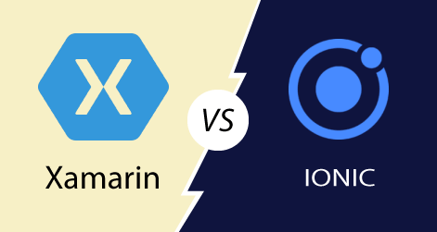
Xamarin & Ionic
Xamarin (C#)
Pros: .NET integration, AOT compilation.
Cons: Smaller community.
Ionic (Web Tech)
Pros: Low cost, web developer-friendly.
Cons: WebView performance.

Slide 7
Performance Benchmark
Framework | UI Rendering
React Native | ⭐⭐⭐⭐
Flutter | ⭐⭐⭐⭐⭐
Xamarin | ⭐⭐⭐⭐
Ionic | ⭐⭐
Animation
⭐⭐⭐
⭐⭐⭐⭐⭐
⭐⭐⭐
⭐⭐
Native Access
⭐⭐⭐⭐
⭐⭐⭐
⭐⭐⭐⭐⭐
⭐⭐
Key Insight:
Flutter excels in animations; Xamarin offers best native access.

Slide 8
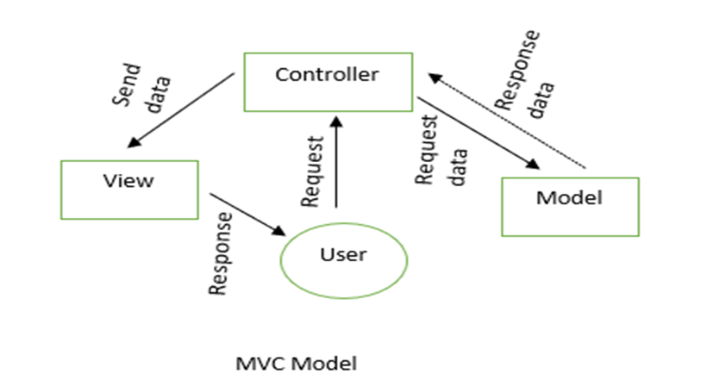
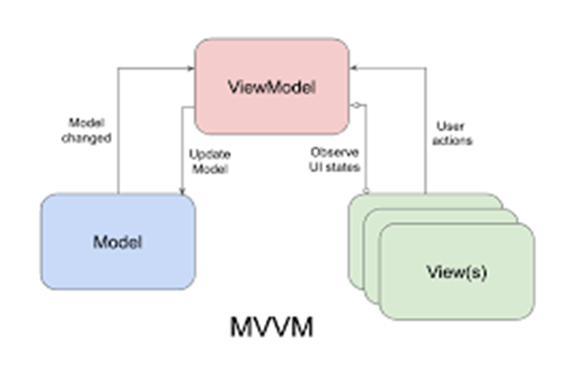
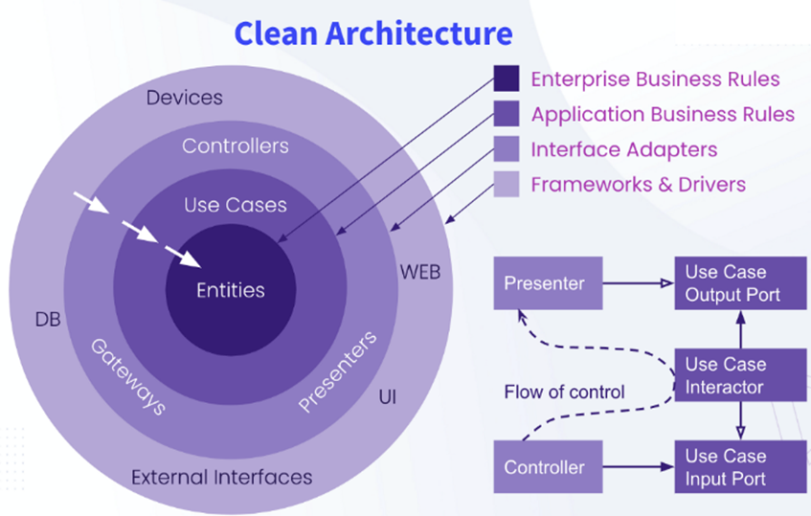
Architecture Patterns
1. MVC
Components: Model-View-Controller.
Use Case: Small apps.
2. MVVM
Components: Model-View-View-Model.
Use Case: Medium apps (team projects).
3. Clean Architecture
Layers: Presentation, Domain, Data.
Use Case: Large enterprise apps.

Slide 9
Design Patterns
Creational: Singleton, Factory Method.
Structural: Adapter, Decorator.
Behavioral: Observer, Strategy.
Example: Singleton for database instance management.

Slide 10
Best Practices
01
02
03
04
05
Modular design for reusability.
Dependency injection for loose coupling.
Rigorous testing (unit, integration).
Optimize network calls and caching.
Follow SOLID principles.

Slide 11
Gathering App Requirements
Steps:
Define app purpose.
Align with business goals.
Market/competitor analysis.
Create user personas.
Prioritize functional/non-functional needs.
Requirement Analysis Techniques
Gap analysis
Gantt charts
Integrated definition of function modeling (IDEF)
Role-Activity Diagram (RAD)
Data flow diagrams
The Flowchart Technique
Unified Modeling Language
Business Process Modeling Notation (BPMN)

Slide 12
Cost Estimation Factors
Key Factors:
App complexity (MVP vs. enterprise).
Platform (iOS, Android, cross-platform).
Design (UI/UX).
Team location (hourly rates vary).

Slide 13
Cost Estimation Formula
Formula:
Cost = Total Development Time × Hourly Rate
Example:
500 hours × $50/hour = $25,000.
Models: Fixed Price, Hourly, Stage-based.
Cost Reduction Tactics
Prioritize MVP features.
Use cross-platform frameworks.
Outsource strategically.
Agile development.

Slide 14
Conclusion
Native apps for performance, hybrid for cost.
Flutter and React Native lead in frameworks.
Clean Architecture ensures scalability.
Detailed requirements and cost planning are critical.

Slide 15
THANK YOU
Questions?

